Slide 1
Ensemble Learning

Slide 2
Ensemble Learning
So far – learning methods that learn a single hypothesis, chosen form a hypothesis space that is used to make predictions.
Ensemble learning → select a collection (ensemble) of hypotheses and combine their predictions.
Example 1 - generate 100 different decision trees from the same or different training set and have them vote on the best classification for a new example.
Key motivation: reduce the error rate. Hope is that it will become much more unlikely that the ensemble of will misclassify an example.

Slide 3
Ensemble-based Systems in Decision Making
For many tasks, we often seek second opinion before making a decision, sometimes many more
Consulting different doctors before a major surgery
Reading reviews before buying a product
Requesting references before hiring someone
We consider decisions of multiple experts in our daily lives
Why not follow the same strategy in automated decision making?
Multiple classifier systems, committee of classifiers, mixture of experts, ensemble based systems
3
Notes:
3

Slide 4
Ensemble-based Classifiers
Ensemble based systems provide favorable results compared to single-expert systems for a broad range of applications & under a variety of scenarios
How to (i) generate individual components of the ensemble systems (base classifiers), and (ii) how to combine the outputs of individual classifiers?
Popular ensemble based algorithms
Bagging, boosting, AdaBoost, stacked generalization, and hierarchical mixture of experts
Commonly used combination rules
Algebraic combination of outputs, voting methods, behavior knowledge space & decision templates
4
Notes:
4

Slide 5
Why Ensemble Based Systems?
Statistical reasons
A set of classifiers with similar training performances may have different generalization performances
Combining outputs of several classifiers reduces the risk of selecting a poorly performing classifier
Large volumes of data
If the amount of data to be analyzed is too large, a single classifier may not be able to handle it; train different classifiers on different partitions of data
Too little data
Ensemble systems can also be used when there is too little data; resampling techniques
5
Notes:
5

Slide 6
Why Ensemble Based Systems?
Data Fusion
Given several sets of data from various sources, where the nature of features is different (heterogeneous features), training a single classifier may not be appropriate (e.g., MRI data, EEG recording, blood test,..)
Applications in which data from different sources are combined are called data fusion applications
Ensembles have successfully been used for fusion
All ensemble systems must have two key components:
Generate component classifiers of the ensemble
Method for combining the classifier outputs
6
Notes:
6

Slide 7
Brief History of Ensemble Systems
Dasarathy and Sheela (1979) partitioned the feature space using two or more classifiers
Schapire (1990) proved that a strong classifier can be generated by combining weak classifiers through boosting; predecessor of AdaBoost algorithm
Two types of combination:
classifier selection
Each classifier is trained to become an expert in some local area of the feature space; one or more local experts can be nominated to make the decision
classifier fusion
All classifiers are trained over the entire feature space; fusion involves merging the individual (weaker) classifiers to obtain a single (stronger) expert of superior performance
7
Notes:
7

Slide 8
Diversity of Ensemble
Objective: create many classifiers, and combine their outputs to improve the performance of a single classifier
Intuition: if each classifier makes different errors, then their strategic combination can reduce the total error!
Need base classifiers whose decision boundaries are adequately different from those of others
Such a set of classifiers is said to be diverse
How to achieve classifier diversity?
Use different training sets to train individual classifiers
How to obtain different training sets?
Resampling techniques: bootstrapping or bagging, training subsets are drawn randomly, usually with replacement, from the entire training set
8
Notes:
8

Slide 9
Learning Ensembles
Learn multiple alternative definitions of a concept using different training data or different learning algorithms.
Combine decisions of multiple definitions, e.g. using weighted voting.
Training Data
⋅ ⋅ ⋅ ⋅ ⋅ ⋅ ⋅ ⋅
Data1
Data2
Data m
Learner1
Learner2
⋅ ⋅ ⋅ ⋅ ⋅ ⋅ ⋅ ⋅
Learner m
⋅ ⋅ ⋅ ⋅ ⋅ ⋅ ⋅ ⋅
Model1
Model2
Model m
Model Combiner
Final Model

Slide 10
Value of Ensembles
“No Free Lunch” Theorem
No single algorithm wins all the time!
When combing multiple independent and diverse decisions each of which is at least more accurate than random guessing, random errors cancel each other out, correct decisions are reinforced.

Slide 11
Example: Weather Forecast
Reality
1
2
3
4
5
Combine
X
X
X
X
X
X
X
X
X
X
X
X
X

Slide 12
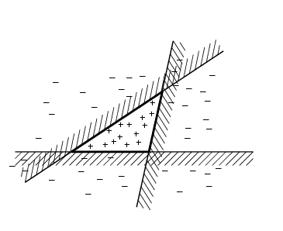
Ensemble Learning
Another way of thinking about ensemble learning:
→ way of enlarging the hypothesis space, i.e., the ensemble itself is a hypothesis and the new hypothesis space is the set of all possible ensembles constructible form hypotheses of the original space.
Increasing power of ensemble learning:
Three linear threshold hypothesis
(positive examples on the non-shaded side);
Ensemble classifies as positive any example classified
positively be all three. The resulting triangular region hypothesis
is not expressible in the original hypothesis space.

Slide 13
Different types of ensemble learning
Different learning algorithms
Algorithms with different choice for parameters
Data set with different features (e.g. random subspace)
Data set = different subsets (e.g. bagging, boosting)

Slide 14
Different types of ensemble learning (1)
Different algorithms, same set of training data
A1
C1
Training
Set L
A2
C2
…
…
An
Cn
A: algorithm I; C: classifier

Slide 15
Different types of ensemble learning (2)
Same algorithm, different parameter settings
C1
P1
Training
Set L
A
P2
C2
Pn
…
Cn
P: parameters for the learning algorithm

Slide 16
Different types of ensemble learning (3)
Same algorithm, different versions of data set, e.g.
Bagging: resample training data
Boosting: Reweight training data
Decorate: Add additional artificial training data
RandomSubSpace (random forest): random subsets of features
L1
C1
Training
Set L
L2
A
C2
…
…
Ln
Cn

Slide 17
Combining Class Labels
Assume that only class labels are available from the classifier outputs
Define the decision of the t^{th} classifier as d_{t,j}∈{0,1} , t=1,…,T and j=1,…,C , where T is the number of classifiers and C is the number of classes
If t^{th} classifier chooses class ω_{j} , then d_{t,j}=1, 0 otherwise
Majority Voting :
Weighted Majority Voting –
Behavior Knowledge Space (BKS) – look up Table
Borda Count – each voter (classifier) rank orders the candidates (classes). If there are N candidates, the first-place candidate receives N − 1 votes, the second-place candidate receives N − 2, with the candidate in i^{th} place receiving N − i votes. The votes are added up across all classifiers, and the class with the most votes is chosen as the ensemble decision

Slide 18
Combining Continuous Outputs
Algebraic combiners
Mean Rule:
Weighted Average:
Minimum/Maximum/Median Rule:
Product Rule:
Generalized Mean:
Many of the above rules are in fact special cases of the generalized mean
: minimum rule; :maximum rule; :
: mean rule

Slide 19
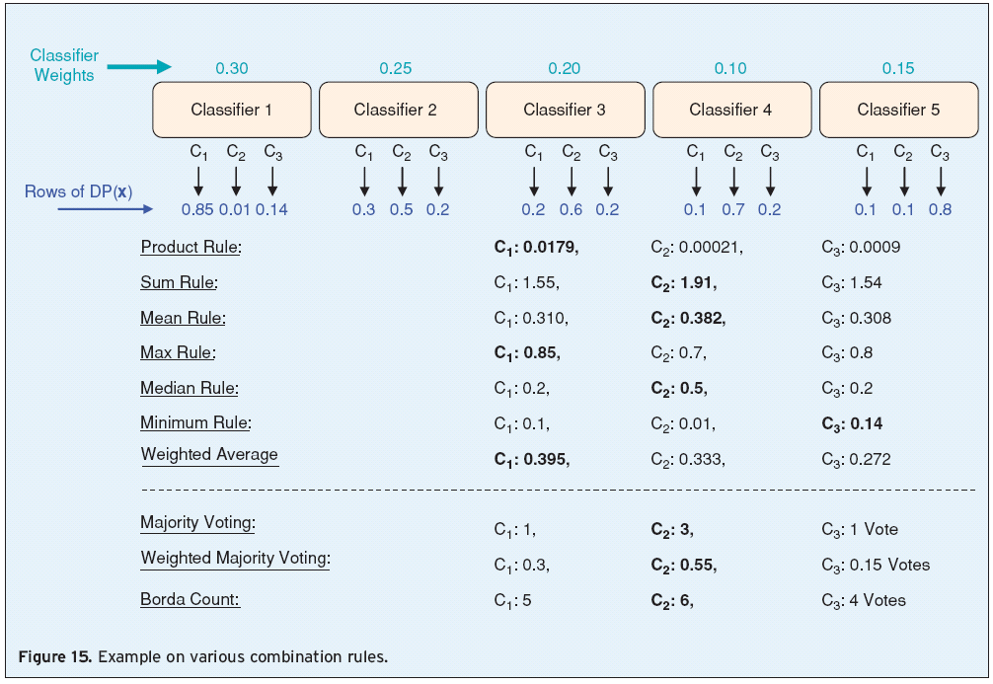
Combining Classifier Outputs
19
Notes:
19

Slide 20
Bagging
Create ensembles by “bootstrap aggregation”, i.e., repeatedly randomly resampling the training data (Brieman, 1996).
Bootstrap: draw N items from X with replacement
Each bootstrap sample will on average contain 63.2% of the unique training examples, the rest are replicates.
Bagging
Train M learners on M bootstrap samples
Combine outputs by voting (e.g., majority vote)
Decreases error by decreasing the variance in the results due to unstable learners, algorithms (like decision trees and neural networks) whose output can change dramatically when the training data is slightly changed.

Slide 21
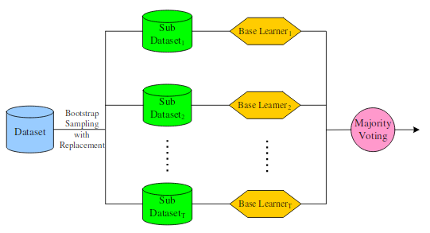
Bagging

Slide 22
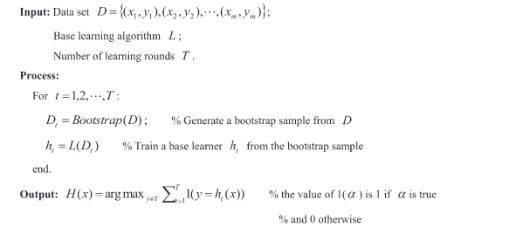
Bagging - Aggregate Bootstrapping

Slide 23
Boosting
Originally developed by computational learning theorists to guarantee performance improvements on fitting training data for a weak learner that only needs to generate a hypothesis with a training accuracy greater than 0.5 (Schapire, 1990).
Revised to be a practical algorithm, AdaBoost, for building ensembles that empirically improves generalization performance (Freund & Shapire, 1996).
Key Insights:
Instead of sampling (as in bagging) re-weigh examples!
Examples are given weights. At each iteration, a new hypothesis is learned (weak learner) and the examples are reweighted to focus the system on examples that the most recently learned classifier got wrong.
Final classification based on weighted vote of weak classifiers

Slide 24
Construct Weak Classifiers
Using Different Data Distribution
Start with uniform weighting
During each step of learning
Increase weights of the examples which are not correctly learned by the weak learner
Decrease weights of the examples which are correctly learned by the weak learner
Idea
Focus on difficult examples which are not correctly classified in the previous steps
Intuitive justification: models should be experts that complement each other

Slide 25
Combine Weak Classifiers
Weighted Voting
Construct strong classifier by weighted voting of the weak classifiers
Idea
Better weak classifier gets a larger weight
Iteratively add weak classifiers
Increase accuracy of the combined classifier through minimization of a cost function

Slide 26
Boosting

Slide 27
Boosting
Boost the performance of a weak learner to the level of a strong one
Boosting creates an ensemble of classifiers by resampling the data; classifiers combined by majority voting
Resampling is strategically geared to provide the most informative training data for each consecutive classifier
Boosting creates three weak classifiers:
First classifier C1 is trained with a random subset of the available training data
Training set for second classifier C2 is chosen as the most informative subset, given C1; half of the training data for C2 is correctly classified by C1, other half is misclassified by C1
Third classifier C3 is trained on instances on which both C1 & C2 disagree
Notes:
27

Slide 28
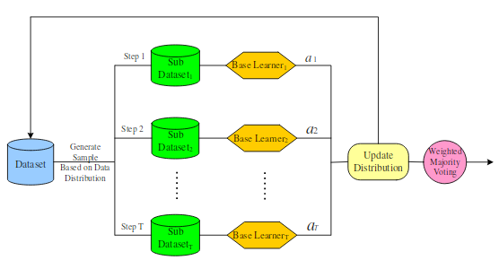
Boosting
Notes:
28

Slide 29
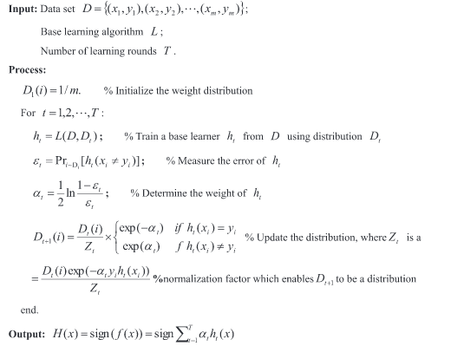
Boosting

Slide 30
AdaBoost
AdaBoost (1997) is a more general version of the boosting algorithm; AdaBoost.M1 can handle multiclass problems
AdaBoost generates a set of hypotheses (classifiers), and combines them through weighted majority voting of the classes predicted by the individual hypotheses
Hypotheses are generated by training a weak classifier; samples are drawn from an iteratively updated distribution of the training set
This distribution update ensures that instances misclassified by the previous classifier are more likely to be included in the training data of the next classifier
Consecutive classifiers are trained on increasingly hard-to-classify samples
Notes:
30

Slide 31
AdaBoost
A weight distribution D_{t}(i) on training instances x_{i} , i=1,…,N from which training data subsets S_{t} are chosen for each consecutive classifier (hypothesis) h_{t}
A normalized error is then obtained as _{t} , such that for 0<_{t} <1/2, they have 0< _{t} <1
Distribution update rule:
The distribution weights of those instances that are correctly classified by the current hypothesis are reduced by a factor of _{t} , whereas the weights of the misclassified instances are unchanged.
AdaBoost focuses on increasingly difficult instances
AdaBoost raises the weights of instanced misclassified by h_{t} , and lowers the weights of correctly classified instances
AdaBoost is ready for classifying unlabeled test instances. Unlike bagging or boosting, AdaBoost uses the weighted majority voting
1/_{t} is therefore a measure of performance, of the t^{th} hypothesis and can be used to weight the classifiers
Notes:
31

Slide 32
Performance of AdaBoost
In most practical cases, the ensemble error decreases very rapidly in the first few iterations, and approaches zero or stabilizes as new classifiers are added
AdaBoost does not seem to be affected by overfitting; explained by margin theory
Notes:
32

Slide 33
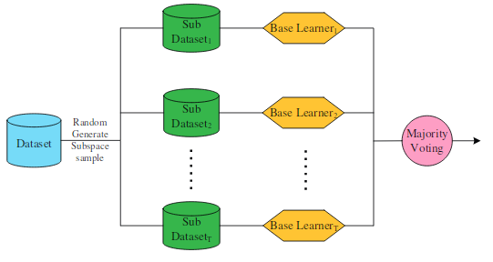
Random Subspace

Slide 34
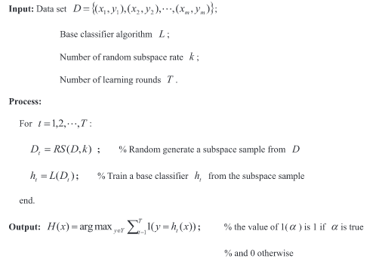
Random Subspace

